Slide 1
Classes
CL217 – Object Oriented Programming

Slide 2
5.1 Basic concepts of object programming

Slide 3
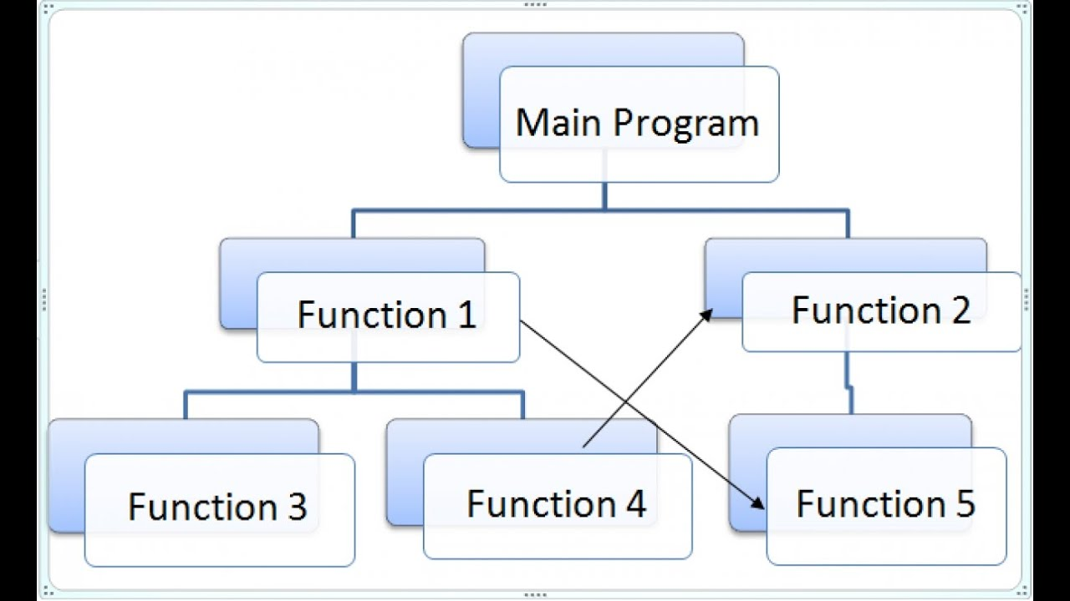
5.1.1 Classes and objects in real life
All of our programs and all the techniques we’ve used up till now fall into the so-called procedural style of programming.

Slide 4
5.1.1 Classes and objects in real life
Procedural programming works very well for simple projects and not large ones.
Large and complex projects carried out by large teams consisting of many developers use Object approach .
C++ language was created as a universal tool for object programming.

Slide 5
5.1.2 Classes and objects in real life
In the procedural approach, we can distinguish two different and separate worlds:
data: populated by variables of different types
code: inhabited by code grouped into functions.
The object approach suggests a completely different way of thinking.
The data and the code are enclosed together in the same world, divided into classes

Slide 6
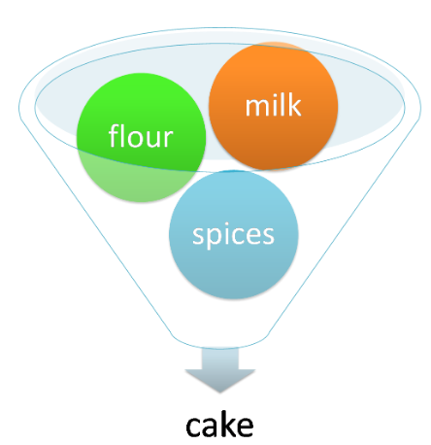
5.1.2 Classes and objects in real life
Every class is like a recipe that can be used when you want to create a useful object
You may produce as many objects as you need to solve your problem.
Every object has a set of properties and is able to perform a set of activities (operations, methods).

Slide 7
5.1.2 Classes and objects in real life
The recipes may be modified if they’re inadequate for specific purposes and, in effect, new classes may be created.
The new classes inherit properties and methods from the originals and usually add some new ones, creating new and more specific tools.
Objects are materializations of ideas expressed in classes
much like a piece of cheesecake on your plate is an incarnation of an idea expressed in the recipe printed in an old cookbook.

Slide 8
Example: Compute rectangle area.
class rectangle {
private:
int length;
int width;
public:
void set_len(int a) {
length=a; }
void set_wid(int a) {
width=a; }
int get_len() {
return length; }
int get_wid() {
return width; }
int area() {
return width*length;}
};
int main()
{
int L, W;
rectangle aobject;
cout<<"Enter the length and width of rectangle(L,W)";
cin>>L>>W;
aobject.set_len(L);
// illegal aobject.length=L; //because, length is private
aobject.set_wid(W);
// illegal aobject.width=W; //because width is private
cout<<"Length:"<<aobject.get_len()<<endl;
cout<<"Width:"<<aobject.get_wid()<<endl;
cout<<"Area: "<<aobject.area()<<endl;
return 0;
}

Slide 9
5.1.3 Class – what is it?
Example of Classes (vehicles).
All vehicles existing (and not yet existing) in the world are related to each other by a single, important feature: the ability to move.
We suggest the following definition for any member of the class vehicles:
vehicles are artificially created entities used for transportation, moved by forces of nature and directed (driven) by humans.

Slide 10
5.1.3 Class – what is it?
The “vehicles” class is very broad. Too broad.
We need to define some more specialized classes.
The specialized classes are (will be) called “sub-classes”.
The “vehicles” class will be a “super-class” for them all.
The most general and the widest class is always at the top (a super) while its descendants are below (subs).

Slide 11
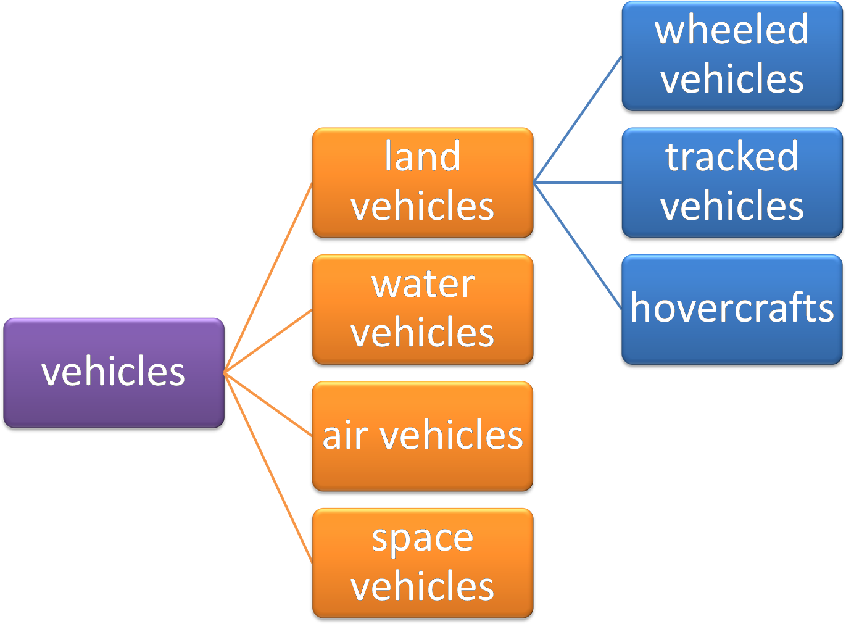
5.1.3 Class – what is it?
Sub classes
Sub classes
Super class

Slide 12
5.1.5 Object – what is it?
Object is an instance of class, which holds the data variables declared in class and the member operations (functions) work on these class objects.
You can create as many objects as you want from the same class.

Slide 13
5.1.5 Object – what is it?
For example:
any personal car is an object that belongs to the “wheeled vehicles” class.
It also means that the same car belongs to all the superclasses of its home class; therefore, it’s a member of the “vehicles” class, too.
Each subclass is more specialized (or more specific) than its superclass.
Each superclass is more general (more abstract) than all its subclasses.

Slide 14
5.1.7 What does any object have?
The object programming convention assumes that every existing object may be equipped with three groups of attributes:
A name that uniquely identifies it
A set of individual properties ( attributes)
A set of abilities to perform specific activities that can change the object itself (operations)

Slide 15
5.1.7 What does any object have?
There’s a hint that can help you identify any of these three spheres. Whenever you describe an object and you use:
a noun, you probably define the object’s name
adjective, you probably define the object’s property
a verb, you probably define the object’s activity

Slide 16
5.1.7 What does any object have?
Example 1:
“Max is a large cat who sleeps all day”
Object name = Max
Home class = Cat
Property = Size (large)
Activity = Sleep (all day)
Example 2:
“A pink Cadillac went quickly”
Object name = Cadillac
Home class = Wheeled vehicles
Property = Colour (pink)
Activity = Drive (quickly)

Slide 17
5.1.8 Why all this?
The class you define has nothing to do with object creation
The class itself isn’t able to create an object – you have to create it yourself.
It’s now time to show you how to define the simplest class and how to create an object.
class OurClass{ };
The definition begins with the keyword class.
The keyword is followed by an identifier that names the class
Next, you add a pair of curly brackets.
The content inside these define all the class properties and activities.
Our curly brackets are empty, so the class is empty too.

Slide 18
5.1.9 The very first object
The newly defined class becomes an equivalent of a data type, and we can use it as a type name.
Imagine that we want to create one object of the OurClass class.
We declare a variable that can store objects of that class and create an object at the same time.
OurClass ourObject;

Slide 19
5.3 Anatomy of the class

Slide 20
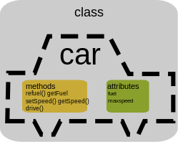
5.3.1 Class components
A class is an aggregate consisting of variables (also called fields or properties) and functions (sometimes called operations/methods).
Both variables and functions are class components /members.

Slide 21
5.3.2 Access specifier
Three categories of class members
private (default)
Member cannot be accessed outside the class
Public
Member is accessible outside the class
Protected
Used with inheritance (next chapter)
Any member (variable or function) can be public, private or protected

Slide 22
5.3.2 Access specifiers
The following class has three components:
one variable of type int called value
two functions called setVal and getVal respectively.
class is named Class.
class Class {
int value;
void setVal(int value);
int getVal(void);
};
Since all the components are declared without the use of an access specifier, all three components are private

Slide 23
5.3.2 Access specifiers
The setVal and getVal components are public – they’re accessible to all users of the class.
The value component is private – it’s accessible only within the class.
class Class {
public:
void setVal(int value);
int getVal(void);
private:
int value;
};

Slide 24
5.3.3 Creating an object
Any object of the class is equipped with all the components defined in the class.
Class the_object();
The public components are available for use. You can do this:
the_object.setVal(0);
The private components are hidden and unavailable. You mustn’t do this:
the_object.value = 0; //Syntax Error

Slide 25
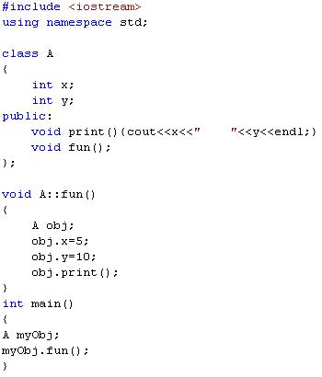
Example:
We can define the function member inside the class
We can define the function member outside the class using :: operator
x y
void fun();
void print();
myObj

Slide 26
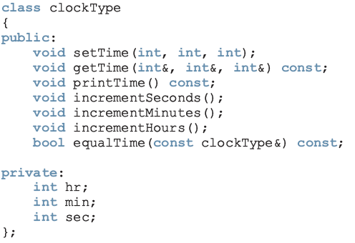
Example
const: formal parameter can’t modify
the value of the actual parameter
These functions cannot modify the member variables of a variable of type clockType
private members,
can’t be accessed from outside the class

Slide 27
Class Functions
Getter function: member function that only accesses the value(s) of member variable(s)
Setter function: member function that modifies the value(s) of member variable(s)
Constant function:
Member function that cannot modify member variables
Use const in function heading

Slide 28
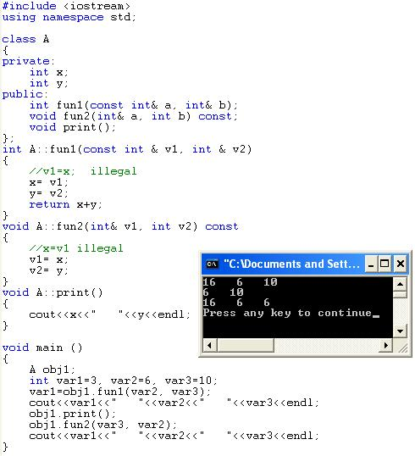
Example:

